Slide 1
History and Moral Philosophy:
Hunters and Gatherers: Background
J. Bradford DeLong
Economics and Blum Center of U.C. Berkeley, WCEG, and NBER
delong@econ.berkeley.edu http://bradford-delong.com @delong
https://www.icloud.com/keynote/0gpMaqZkyvrfqgrfeFkSdZhrA https://tinyurl.com/20180821g-delong
<https://github.com/braddelong/public-files/blob/master/module-gatherers-#Macro-#MRE.pptx>
http://bradford-delong.com brad.delong@gmail.com

Slide 2
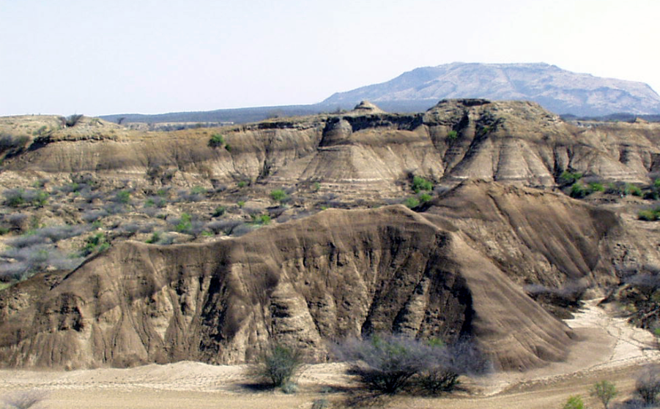
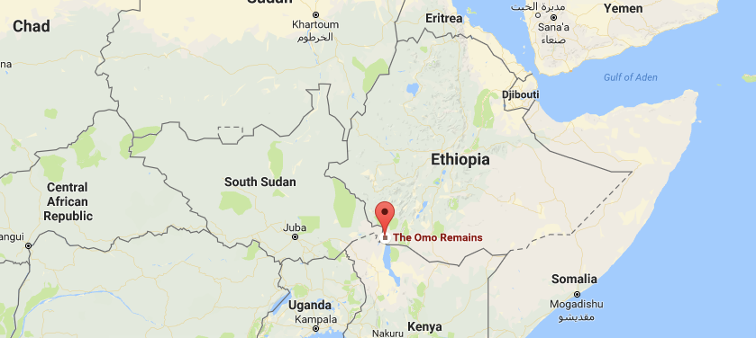
Lecture: Background: Malthusian Economic Growth 70000 BC - 1500
Anatomically modern humans—Home Sapiens Sapiens—evolved about 200,000 years ago:
In the Horn of Africa.
Omo Kibish remains in Ethiopia.
Behaviorally modern humans:
80KYrs ago? 50KYrs ago?
Gradual or sudden?

Slide 3
Behaviorally Modern Humans
Behaviorally modern humans:
120 KYrs ago: 80KYrs ago? 50KYrs ago?
Gradual or sudden?
Why?
Toba (Indonesia) supereruption of 75K BC…?

Slide 4
Near Extinction?
Toba (Indonesia) volcanic supereruption of 75K BC:
Did it matter? Did it knock our breeding population down to >10K—did we almost go extinct?
Or was it not an event important for our development at all?
Did, instead, >10K of us gain key advantageous traits of behavioral modernity, and then out compete the rest?

Slide 5
Or Rapid Semi-Speciatio ?
Did >10K of us gain key advantageous traits of behavioral modernity, and then out compete the rest?
John Hawks: The So-Called Toba Bottleneck Didn't Happen http://johnhawks.net/weblog/reviews/climate/toba-bottleneck-didnt-happen-2018.html:
Dates of population expansion have little connection to the dates of population contraction…
Effective population size might be orders of magnitude smaller than the actual human population…
Human populations in the coldest climate zones, like the Neandertals of Europe, never seemed to show any obvious signs of population reduction at the time of the Toba event…
Aerosols that cool global climate, like sulfur dioxide, did not scale with the volume of rock ejected by the Toba eruption...

Slide 6
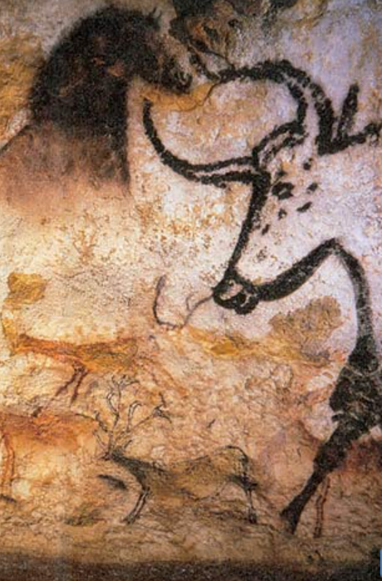
Behaviorally Modern Humans
By 50KYrs ago…
Archaeological evidence of behavioral modernity:
Art: cave paintings, petroglyphs, figurines
Pigment and jewelry for adornment
Bone tools
Long-distance transport
Blades
Hearths
Regional distinctions but standardization within regions
burial
Culture and civilization growing—both to make us more productive, make our lives easier, and make ourselves happier at least in the sense of thinking that the world makes sense and we have a purpose…
An anthology intelligence

Slide 7
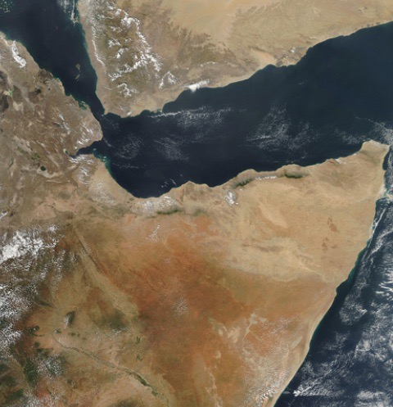
Radiation from the Horn to the Rest of and Out of Africa 50,000 Years Ago?
“Some 70,000 years ago, a part of the bearers of mitochondrial haplogroup L3 migrated from East Africa into the Near East…. From a population of 2,000 to 5,000 in Africa… possibly as few as 150 to 1,000 people, crossed the Red Sea…”
India as their first apparent stop…
Then radiation to Eurasia, Australasia—and then the Americas, Oceania…

Slide 8
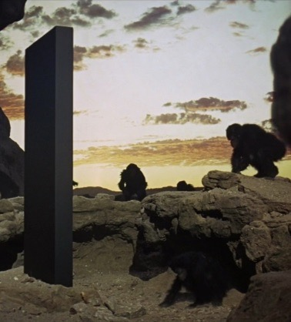
What Made Us Behaviorally Modern?
Sociability:
About like baboons
More sociable than our chimp, gorilla, orangutang cousins
Bonobos?
We don’t just use language:
We gossip
Constantly
Even when we know we shouldn’t…
Thus we become an anthology intelligence.
What one person learns, soon everybody knows.
Complex, composite tools.
Making tools vs., say, building nests
And a cooperative anthology intelligence…

Slide 9
We Spread Out Across the World
Perhaps 5K 70K years ago?
Narrowly located in the Horn of Africa
Gene flow from other, closely related populations
Perhaps 5M 10K years ago
Growth factor of 2500 over 60K years…

Slide 10
To Your iClickers…
Growth factor of 2500 over 60K years is…
0.013%/year —> 5000 yr doubling… 12 doublings… 2^10 = 1024
0.042%/year
0.0042%/year
1.3%/year
None of the above

Slide 11
To Your iClickers…
Growth factor of 2500 over 60K years is, per 30 year generation
0.13%/generation
0.013%/generation
0.0039%/year
3.9%/generation
0.39%/generation —> 0.013%/year 1.00013
None of the above

Slide 12
Catch Our Breath…
What are your questions?
What are your comments?
Onward!

